Slide 1
3 LS4-2 Construct on explanation for how the variations in characteristics among individuals of the same species may provide advantages in surviving, finding mates, and reproducing.

Slide 2
Which daisy is most likely to survive? Why?

Slide 3
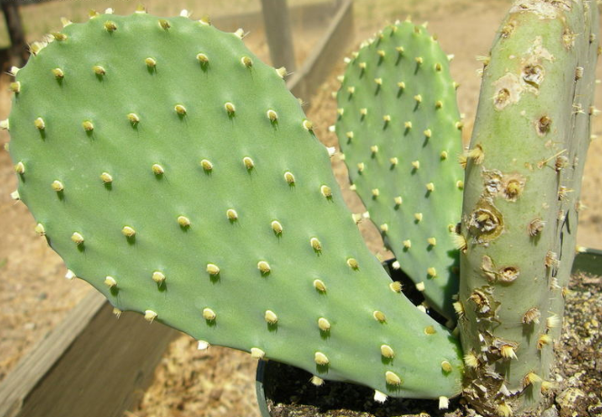
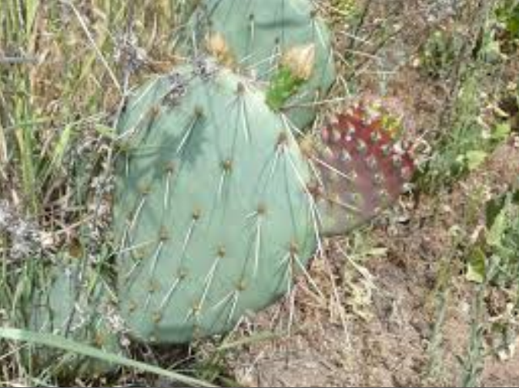
Which cactus is most likely to survive? Why?

Slide 4
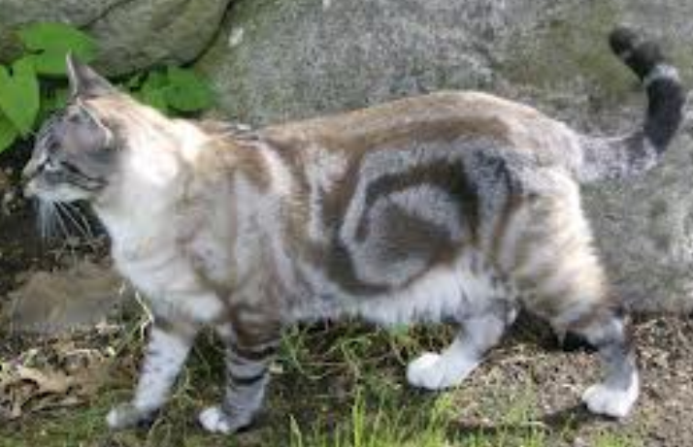
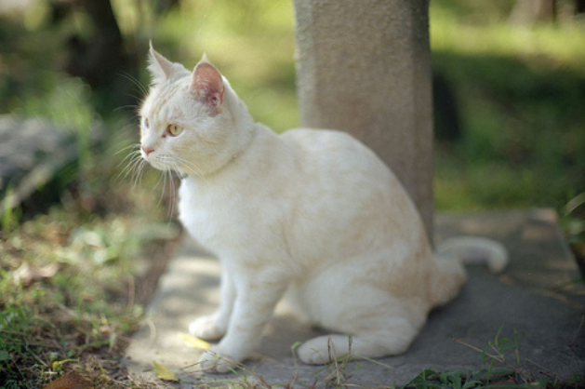
Which cat is most likely to survive? Why?

Slide 5
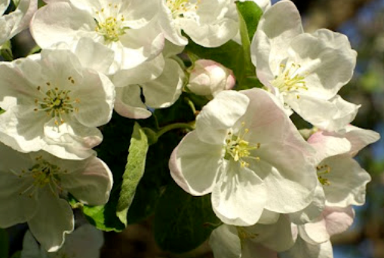
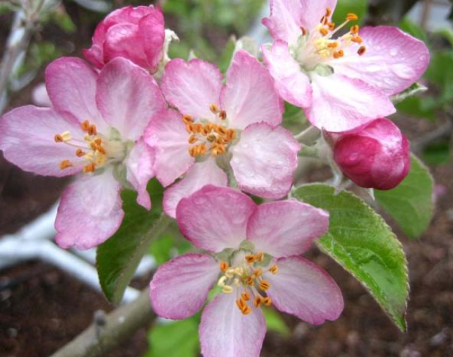
Which apple blossoms are most likely to be pollinated and produce fruit? Why?

Slide 6
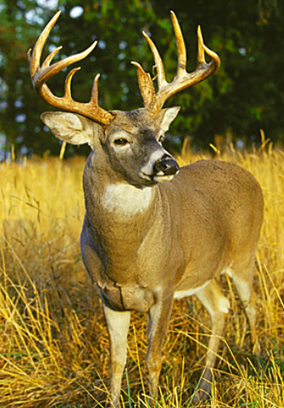
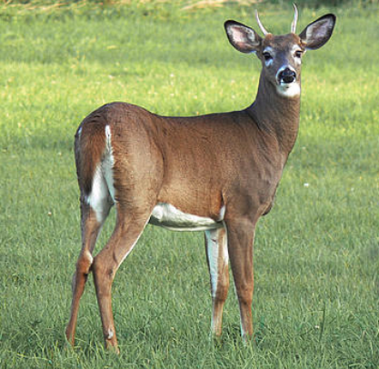
Which buck is most likely to win a fight for a mate? Why?

Slide 7
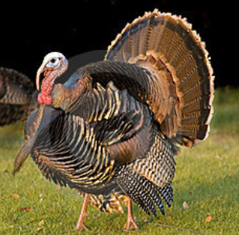
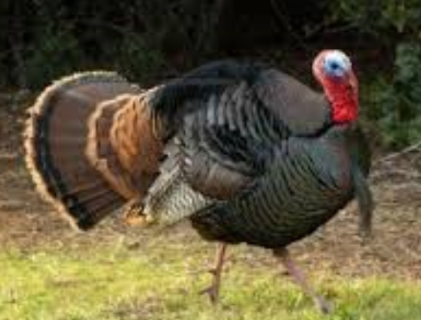
Which turkey is most likely to attract a mate? Why?

Slide 8
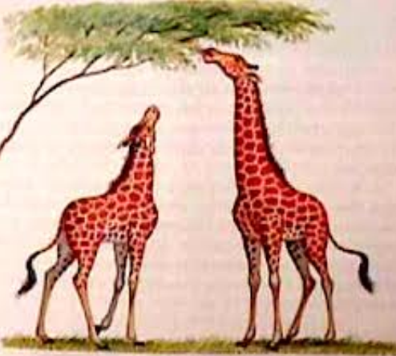
Which giraffe is most likely to survive? Why?

